Slide 1
Architecture of DBMS

Slide 2
Introduction
Database management systems architecture will help us understand the components of database system and the relation among them.
The architecture of DBMS depends on the computer system on which it runs.
For example, in a client-server DBMS architecture, the database systems at server machine can run several requests made by client machine.

Slide 3
Types of DBMS Architecture
There are three types of DBMS architecture:
1. Single tier architecture 2. Two tier architecture 3. Three tier architecture

Slide 4
Single tier architecture
In this type of architecture, the database is readily available on the client machine, any request made by client doesn’t require a network connection to perform the action on the database.
In this architecture, the database is directly available to the user. It means the user can directly sit on the DBMS and uses it.
Any changes done here will directly be done on the database itself. It doesn't provide a handy tool for end users.
The 1-Tier architecture is used for development of the local application, where programmers can directly communicate with the database for the quick response.

Slide 5
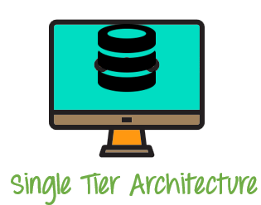

Slide 6
Two tier architecture
The 2-Tier architecture is same as basic client-server. In the two-tier architecture, applications on the client end can directly communicate with the database at the server side. For this interaction, API's like: ODBC, JDBC are used.
The user interfaces and application programs are run on the client-side.
The server side is responsible to provide the functionalities like: query processing and transaction management.
To communicate with the DBMS, client-side application establishes a connection with the server side.

Slide 7
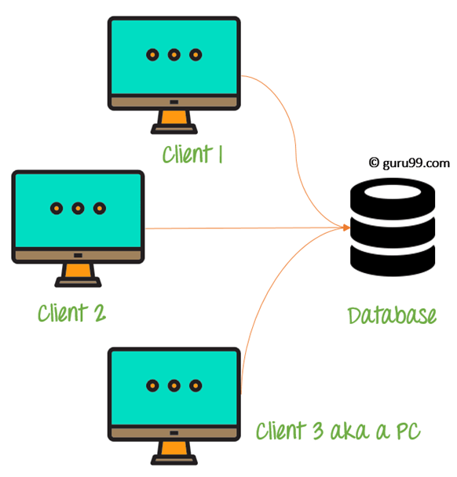

Slide 8
Three tier architecture
The 3-Tier architecture contains another layer between the client and server. In this architecture, client can't directly communicate with the server.
The application on the client-end interacts with an application server which further communicates with the database system.
End user has no idea about the existence of the database beyond the application server. The database also has no idea about any other user beyond the application.
The 3-Tier architecture is used in case of large web application.

Slide 9
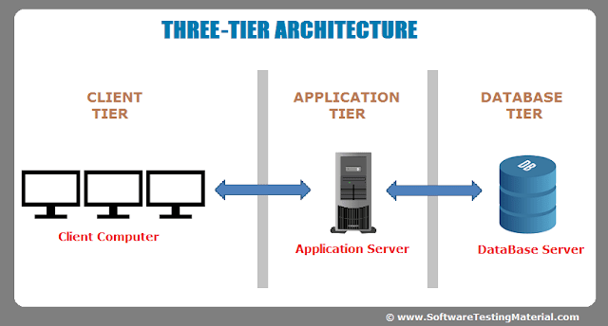

Slide 10
DBMS – Three Level Architecture
This architecture has three levels:
1. External level 2. Conceptual level 3. Internal level

Slide 11
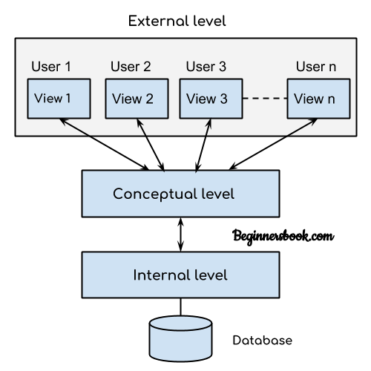

Slide 12
External level
It is also called view level.
The reason this level is called “view” is because several users can view their desired data from this level which is internally fetched from database with the help of conceptual and internal level mapping.

Slide 13
The user doesn’t need to know the database schema details such as data structure, table definition etc. user is only concerned about data which is what returned back to the view level after it has been fetched from database (present at the internal level).
External level is the “top level” of the Three Level DBMS Architecture.

Slide 14
Conceptual level
It is also called logical level. The whole design of the database such as relationship among data, schema of data etc. are described in this level.
Database constraints and security are also implemented in this level of architecture. This level is maintained by DBA (database administrator).

Slide 15
Internal level
This level is also known as physical level.
This level describes how the data is actually stored in the storage devices.
This level is also responsible for allocating space to the data.
This is the lowest level of the architecture.

